Slide 1
2016
Software Engineering
speaker：Tony

Slide 2
CONTENTS
Part 1
Part 2
Part 3
Requirement content
Principle
Tool

Slide 3
Part 1
Requirement content

Slide 4
Requirement content
Definition of requirements
• The descriptions of what the proposed system must do,
•The constraints on the system’s development.
What
Requirement analysis play a decision-making, directional role in the software process.
Key: Understand Interview Prototype
Why
How

Slide 5
What
Business requirements define the business problems to be solved or the business opportunities to be addressed by the software product. They define why the software product is being developed.
User requirements look at the functionality of the software product from the perspectives of the various users of that product. They define what the software has to do in order for the users to accomplishtheir objectives.
Functional requirements specify the software functionality that the developers must build into the product to enable users to accomplish their tasks.They define how to design specific solutions to achieve these requirements.
1.A condition or capability needed by a user to solve a problem or achieve an objective.
2.A condition or capability that must be met or possessed by a system or system component to satisfy a contract, standard, specification, or other formally imposed document.
3.A documented representation of a condition or capability as in 1 or 2.

Slide 6
Why
If we misunderstand the direction in the beginning，all the process behind requirement analysis will be messed up.
Requirement analysis demands negotiation of user and analysis. They balance costs and anticipated benefits of the proposed solutions and make a direction to make sure choice can be accepted by both sides, which can improve efficiency greatly. Requirement analysis also helps user and analysts refine and clear functions of software，figure out limitations in design.

Slide 7
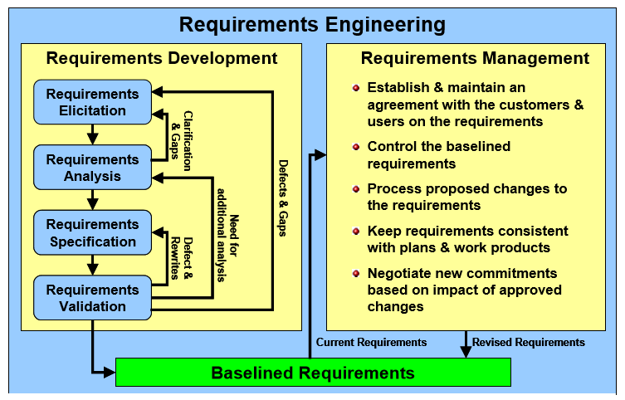
How
First of all, Understanding of all user types and the types of potential customers.
Then, We can interview and investigate to the user. Means of communication can be conference, phone, e-mail, group discussion, simulation demonstration different forms.
In addition, it includes another method, called the prototyping. Prototype is one of the widely used tools in software development.

Slide 8
Part 2
Principle

Slide 9
The first principle: never appear to be more intelligent than the customer
The second principle: Respect the customer's realistic choice
The third principles: the third party is also our customers
The fourth principles: customers and users should be treated differently
The fifth principle: recording requirements with the most simple text tool
The sixth principle: there is no free lunch
Integrity
Necessity
Simplicity
Testability
Correct and Workable
requirement analysis
capture requirement

Slide 10
Part 3
Tool

Slide 11




Software requirement
analysis tool
Axure RP
Star UML
Photoshop
Microsoft visio Rose

Slide 12

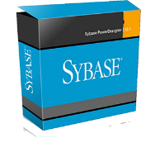
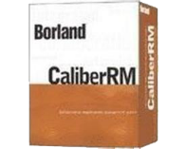


Microsoft Office
Borland Caliber Rm
Power Designer
X Mind
Rational Requisite Pro

Slide 13
THANK
YOU

